Slide 1
The agile methodology
CIS 355 SU18 - Research paper

Slide 2
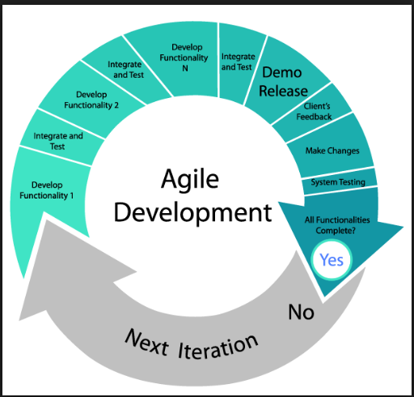
summary
History of Agile
What is it?
Benefits of Agile over Traditional Waterfall Method
Conclusion

Slide 3
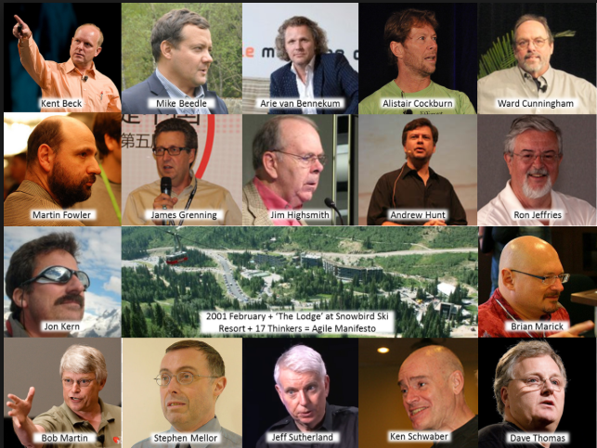
History of agile
What was the cause?
Non-adaptability
Untested Software

Slide 4
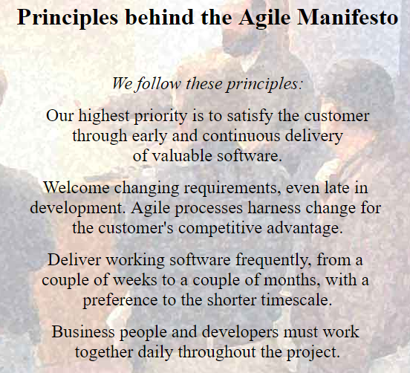
History of agile

Slide 5

What is it?

Slide 6
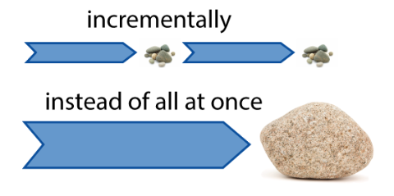
What is it? - Continued

Slide 7
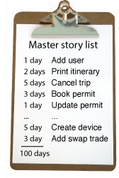
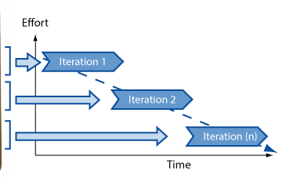
What is it? - Continued
User Stories
Iteration

Slide 8
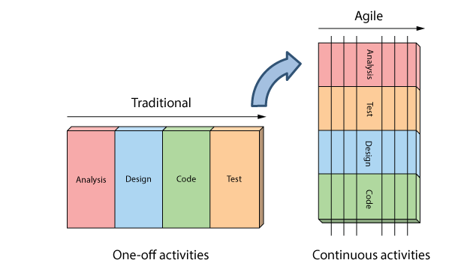
Benefits of Agile over Traditional Waterfall Method

Slide 9

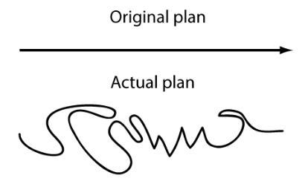

Benefits of Agile over Traditional Waterfall Method
Constant Results
Change of plans mid-process
Complete, tested software

Slide 10
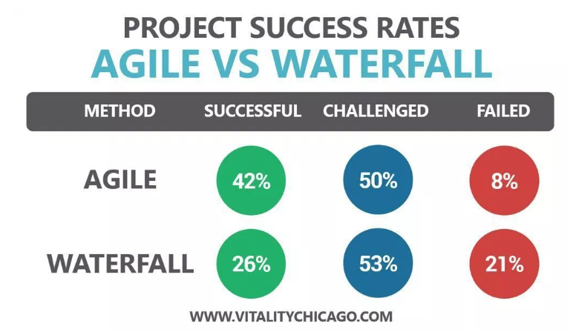
Conclusion

Slide 11

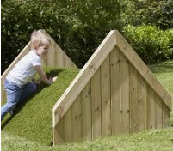
Conclusion
Previous Methodologies
Agile Methodology

